Slide 1
Title: Food and Energy
EQ: Where do the energy numbers come from?

Slide 2
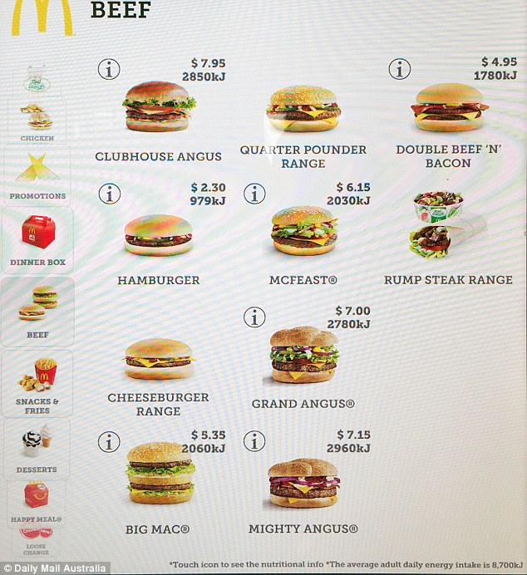
What is energy?
We previously explored the total amount of Kilojoules (Kj) that our bodies need to satisfy our energy requirements.
Kilojoules are an a energy derived from food sources.
Our bodies need many of the kJ we consume for healthy functioning. If we consume more kJ than our bodies use to keep going and for physical activity, the spare energy is stored as fat and we will put on weight. 1 kg of fat = 37,000 kJ stored.
Fast food restaurants include Kj amounts in their menus to advise customers of how much energy is in their food.

Slide 3
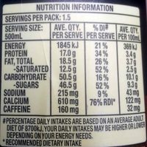
How do we find the kilojoules?
There is a formula for finding the amount of kilojoules that a food source will give you.
The amount of Kilojoules is equal to (17 x Protein content) + (37 x fat content(grams)) + (17 x Carbohydrates)
A Dare iced coffee has 17 grams of protein, 50.5 grams of carbohydrates and 31g of fats.
The total Kilojoules would be 17x17 + 50.5x17 + 31 x17 = 289 + 858.5 + 527= ~1675Kj Per serve.
The value on the right is most likely an over estimation of the energy amount.
The serving size is important her, as these numbers are from a 750ml Dare, and have 1.5 servings in the bottle, so the total energy from the bottle is actually 2512.5Kj.

Slide 4
How many should you be having?
Using BMR calculations we have found the total amount of energy our bodies need during different stages of exercise.
There are also online calculators that take into account your height, weight and age to determine the amount of Kj’s you need for your lifestyle, such as this one: http://www.8700.com.au/kj-explained/your-ideal-figure/
Either is a good guide for your total energy consumptions daily.

Slide 5
Guided practise:
A Big mac has 20g of carbohydrates, 29 grams of fat and 25 grams of protein. What is the Kj of energy that this would give you?
Step 1: substitute the carbohydrates, proteins and fat into the formula.
(17 x25) + (37 x29) + (17 x 20)
Add the answers together to find the total Kj amount.
425+ 1073+340
= 1838Kj
Find the Kilojoule value of a Whopper if it has 30g of protein, 26g of fat and 27g of Carbohydrates.
Remember : 17 x Protein content) + (37 x fat content(grams)) + (17 x Carbohydrates)

Slide 6
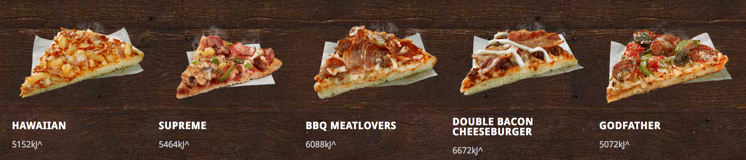
Dietary Intake
They estimate that the average adult requires 8700Kj of energy per day.
If a Big mac is 1838Kj, how much of our dietary intake per day would a Big mac be?
We can find it out by dividing the amount of Kj’s in the food by the 8700kj amount.
(1838Kj / 8700Kj) x 100.
21.13% of the total daily intake in one burger.
If the average Dominoes pizza is around 5500kj, how much of an average adults daily Kj’s would one pizza be?

Slide 7
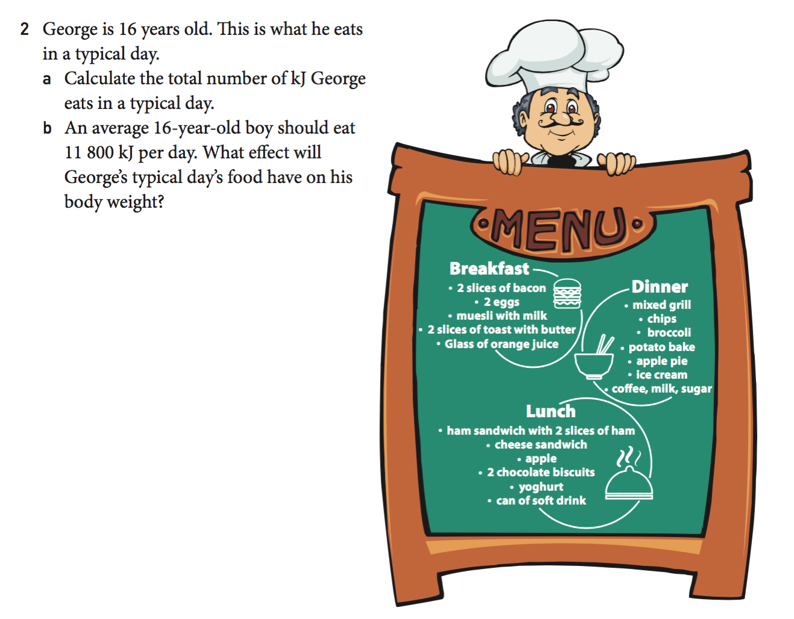
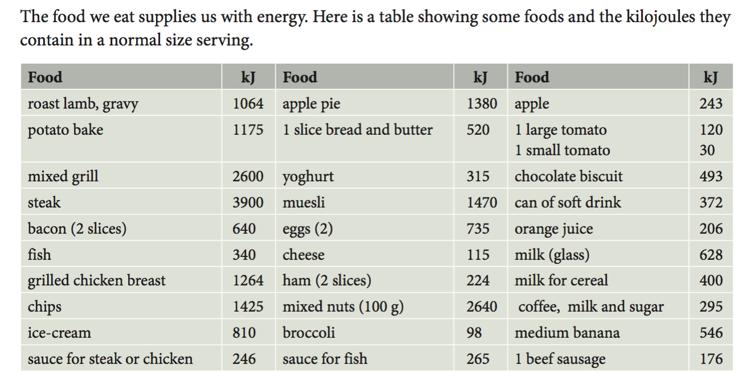
Exercise: Nelson Essentials
Use the table below to answer the questions

Slide 8
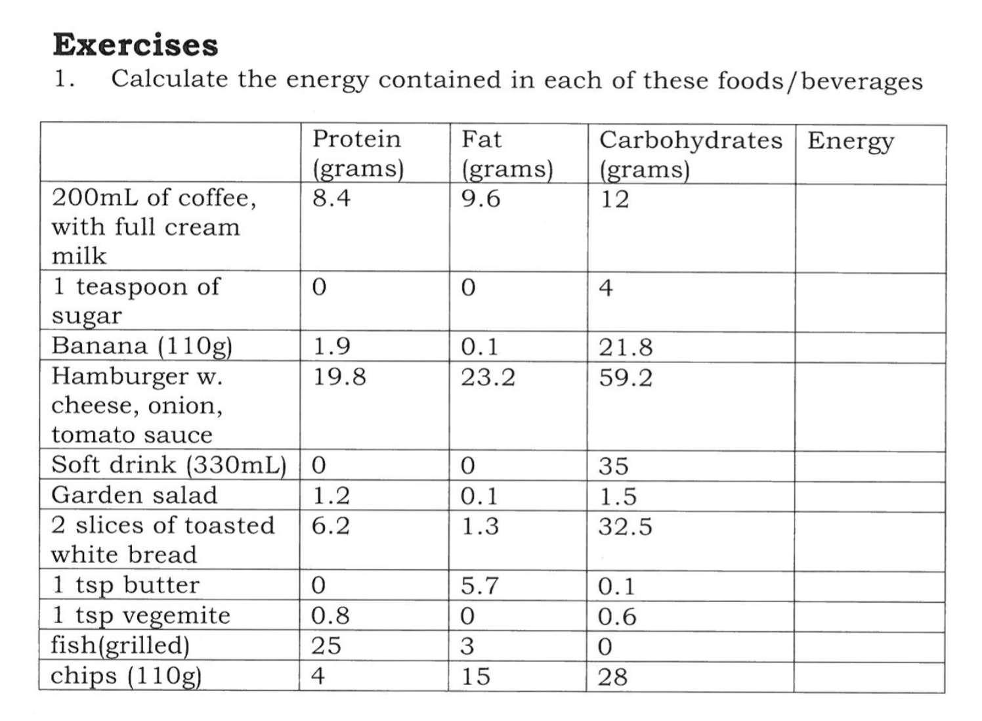
Exercise: MAWA Book 1 and 2 - pg 40
Remember : 17 x Protein content) + (37 x fat content(grams)) + (17 x Carbohydrates)

